Slide 1
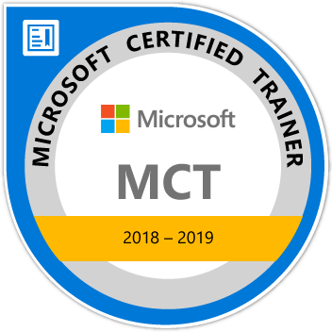
Learning ASP.Net Core
Maruti Makwana
Microsoft Certified Trainer
www.microsofttrainer.in

Slide 2



Slide 3
What is ASP .Net Core?
ASP.NET Core is an open source and cloud-optimized web framework for developing modern web applications that can be developed and run on Windows, Linux and the Mac.
It includes the MVC framework, which now combines the features of MVC and Web API into a single web programming framework.

Slide 4
Why to choose ASP. Net Core?
ASP.NET Core is an open source and cloud-optimized web framework for developing modern web applications that can be developed and run on Windows, Linux and the Mac.
It includes the MVC framework, which now combines the features of MVC and Web API into a single web programming framework.
ASP.NET Core apps can run on .NET Core or on the full .NET Framework.
It was architected to provide an optimized development framework for apps that are deployed to the cloud or run on-premises.

Slide 5
Why to choose ASP. Net Core?
ASP.NET Core apps can run on .NET Core or on the full .NET Framework.
It was architected to provide an optimized development framework for apps that are deployed to the cloud or run on-premises.
Built-in support for dependency injection.
Tag Helpers which makes Razor markup more natural with HTML.
The benefits of a smaller app surface area include tighter security, reduced servicing, improved performance, and decreased costs

Slide 6
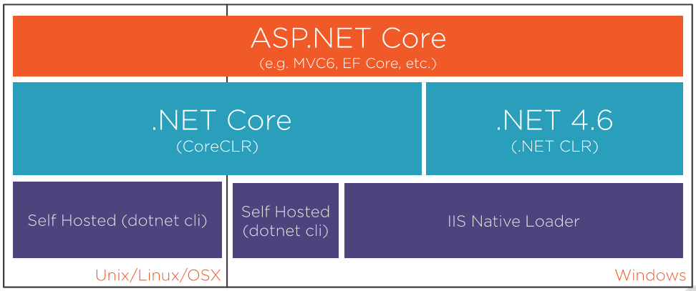

Slide 7
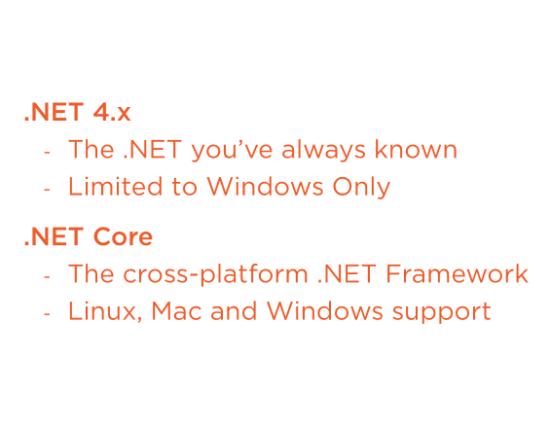

Slide 8
Before ASP.Net Core let’s See.Net Core

Slide 9
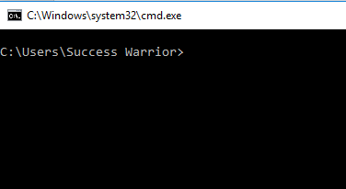
Let’s Understand dotnet code with simple application
Open
Command
prompt

Slide 10
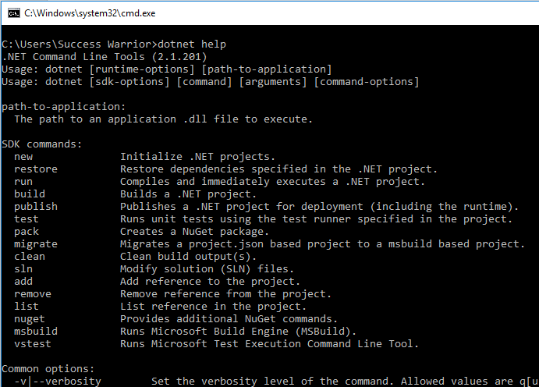

Slide 11
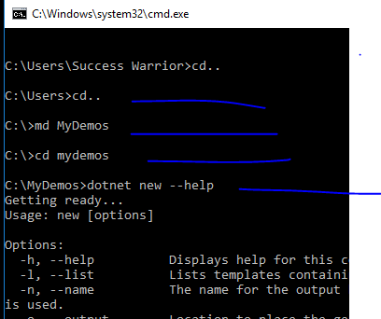

Slide 12
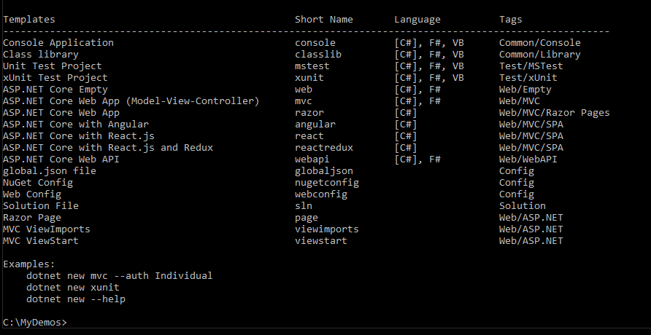
We can create any of these projects using dotnet command

Slide 13
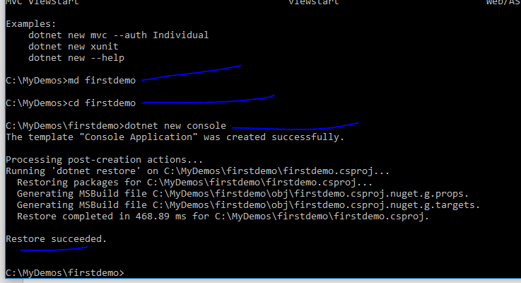
We created new console applicaiton

Slide 14
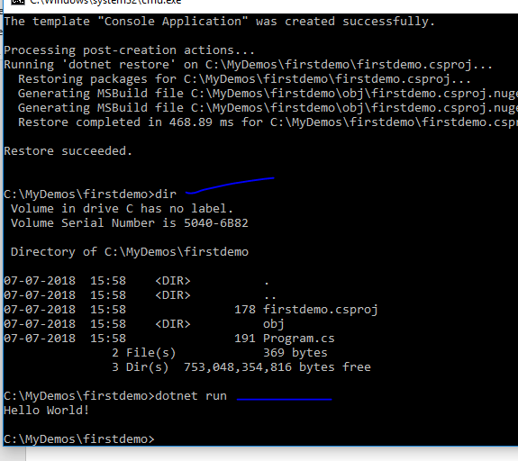
We got new project with very simple project
And its running

Slide 15
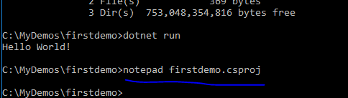
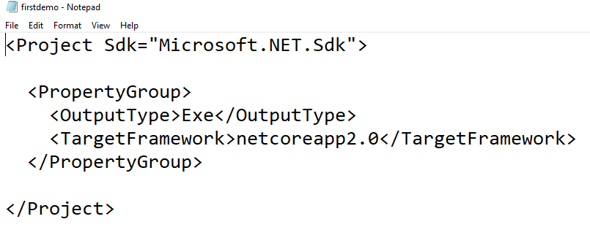
A very simple
csproj file

Slide 16
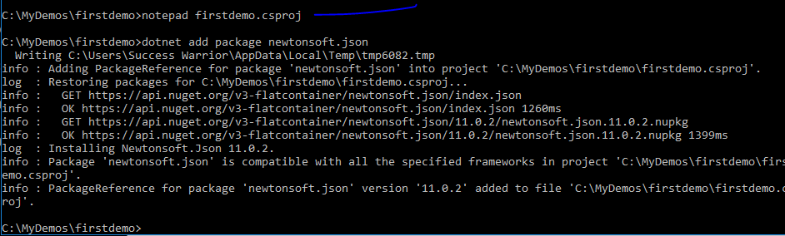
Adding new package using npm

Slide 17
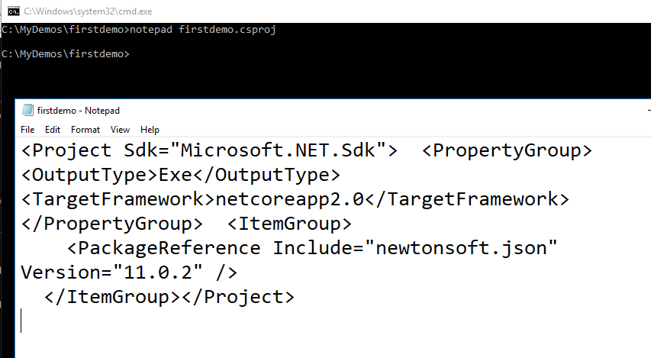
Csproj file will get changed and package is added

Slide 18
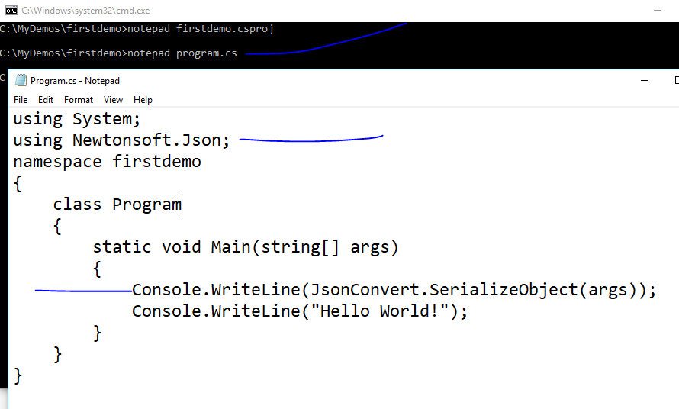

Slide 19
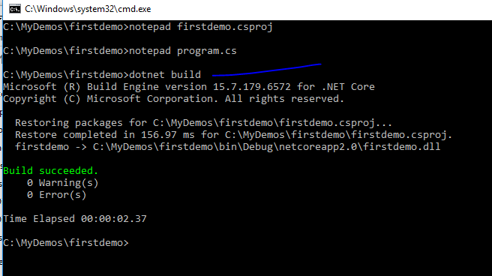

Slide 20
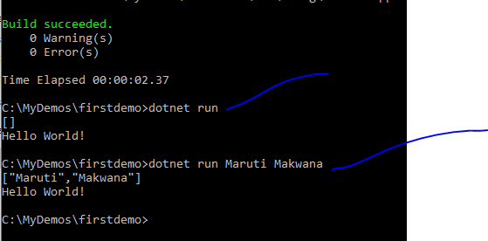

Slide 21
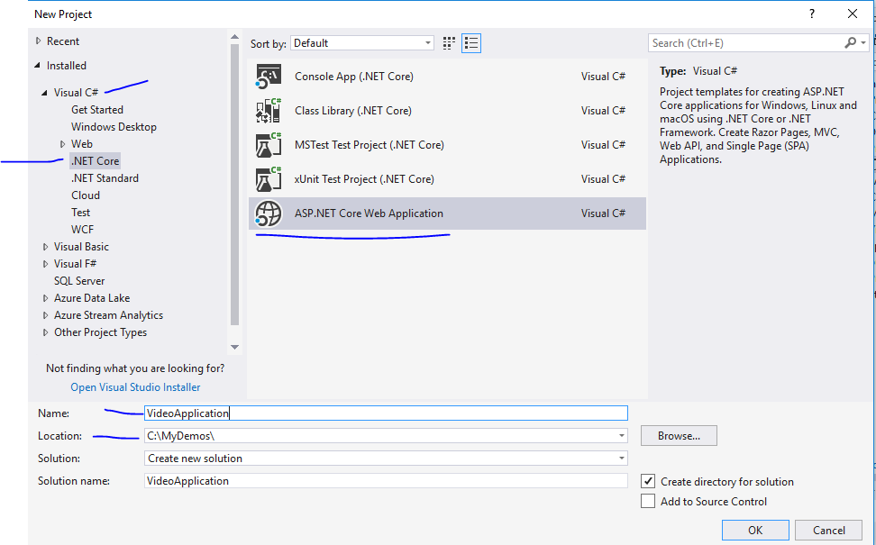

Slide 22
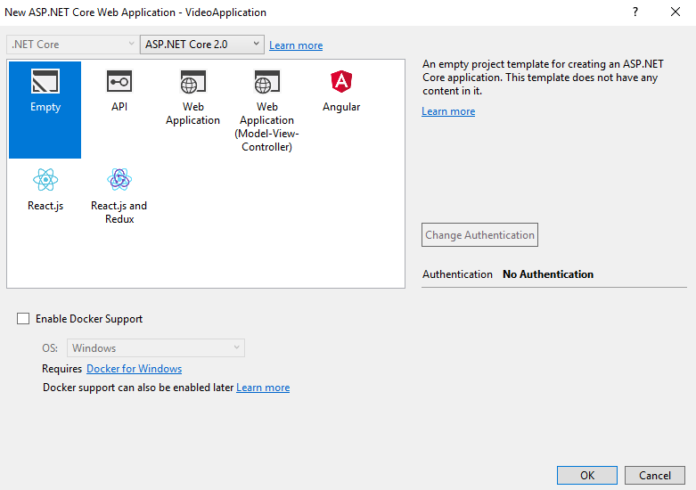

Slide 23
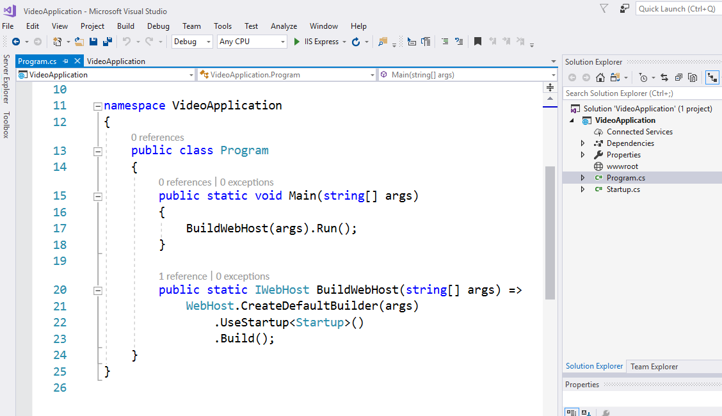

Slide 24
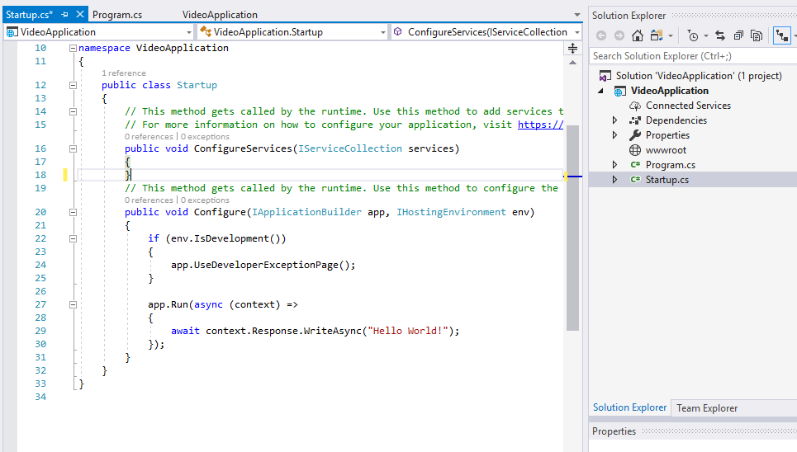
For any request that comes in just write out helloworld

Slide 25
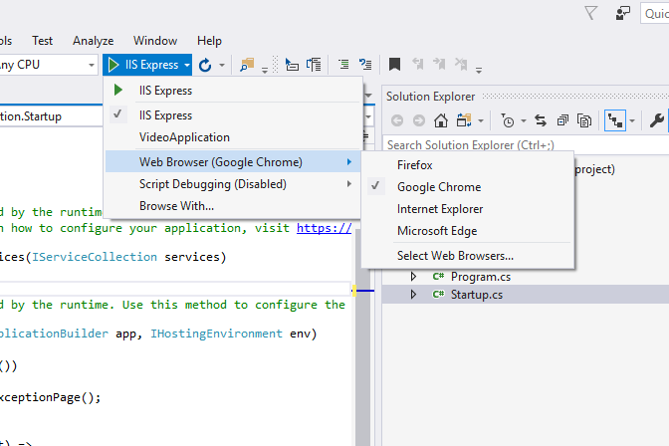

Slide 26
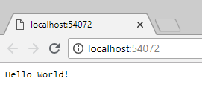
Even if you check view source this is just text
Which we are returning – No html page till now

Slide 27
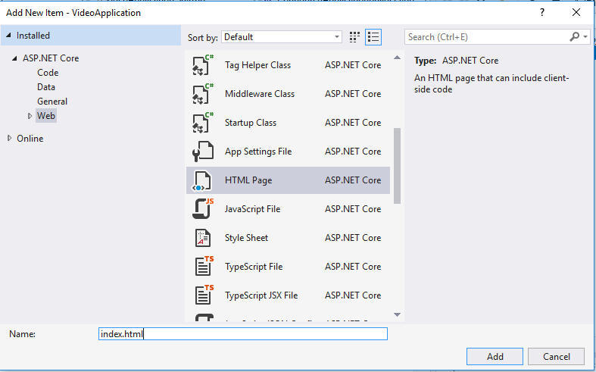

Slide 28
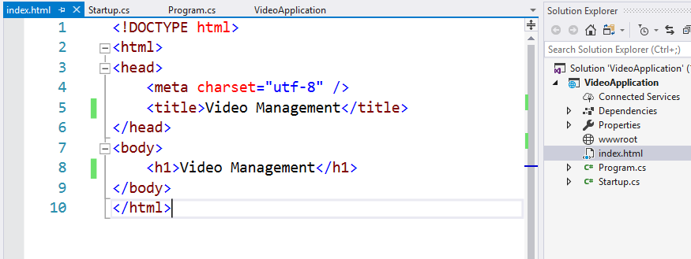

Slide 29
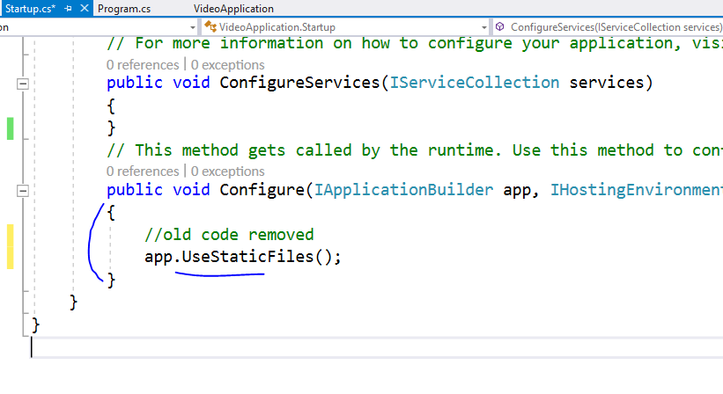

Slide 30
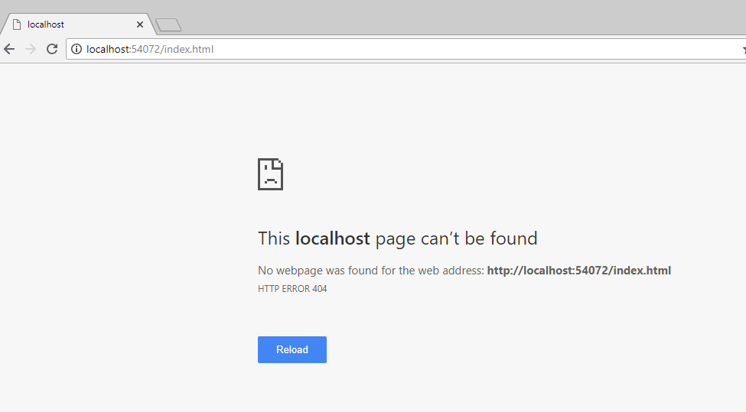
Ooops !!

Slide 32
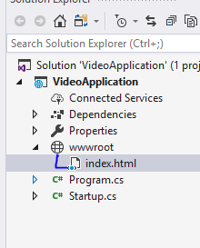
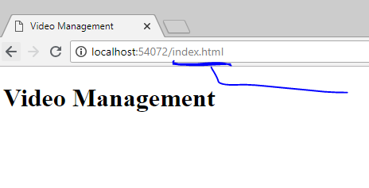
Move index file into wwwroot

Slide 33
All your JS, CSS, HTML and font files will
Always go inside wwwroot folder only

Slide 34
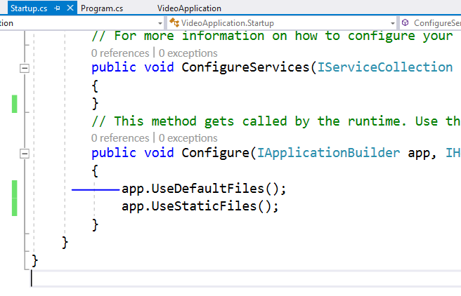
To serve html in this directory please add this
This order is important because
Middleware works based on that

Slide 35
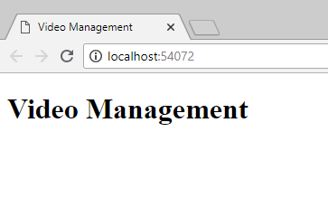
Now index page is visible on base URL

Slide 36
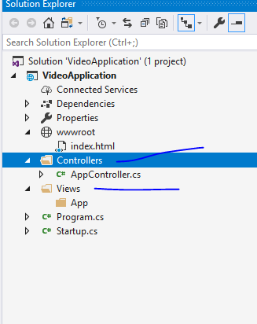
Add folders like this

Slide 37
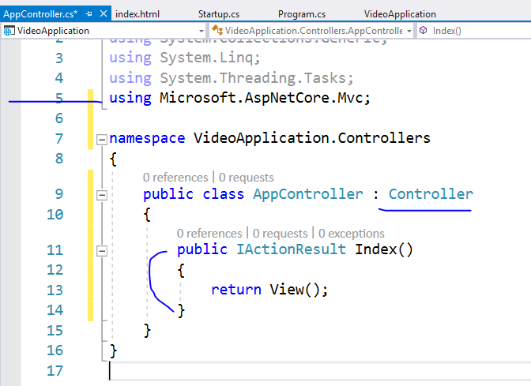
Add code
like this

Slide 38
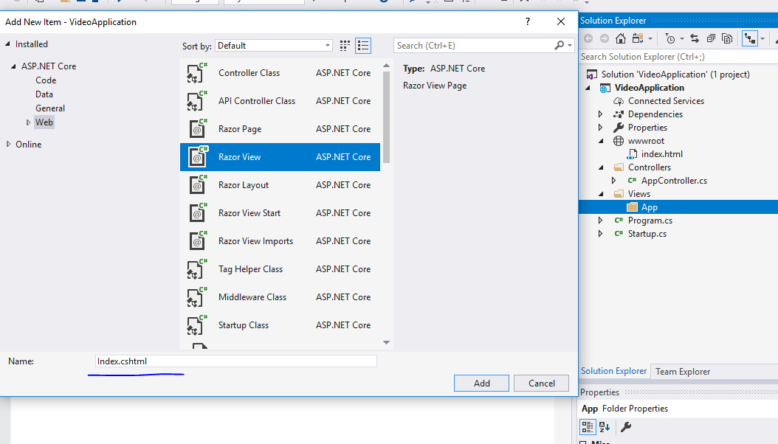

Slide 39
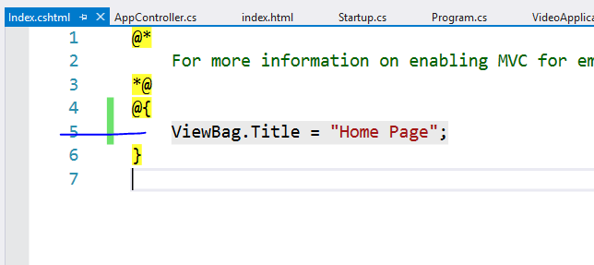

Slide 40
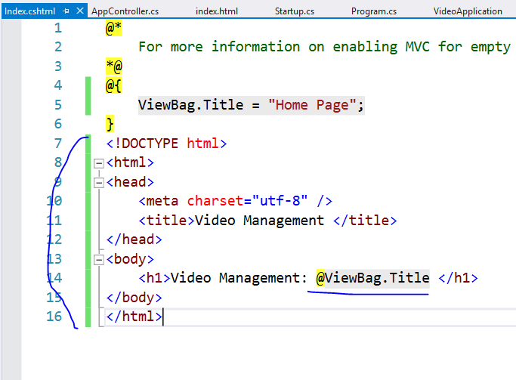

Slide 41
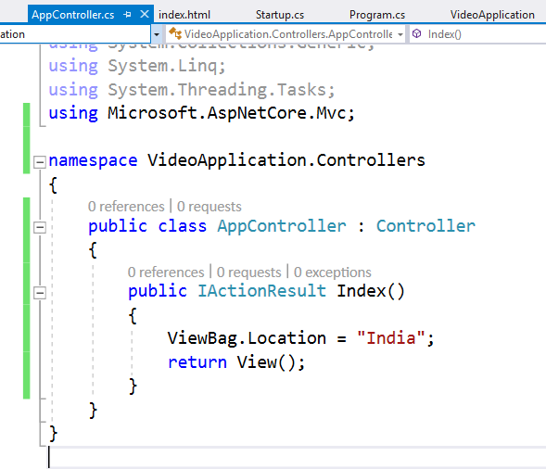

Slide 42
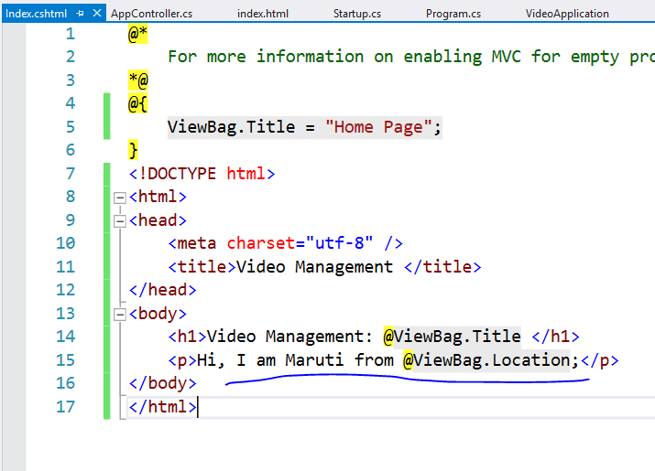

Slide 43
This will not run controller right now
Because we have not enabled MVC in this project
Let’s do it now

Slide 44
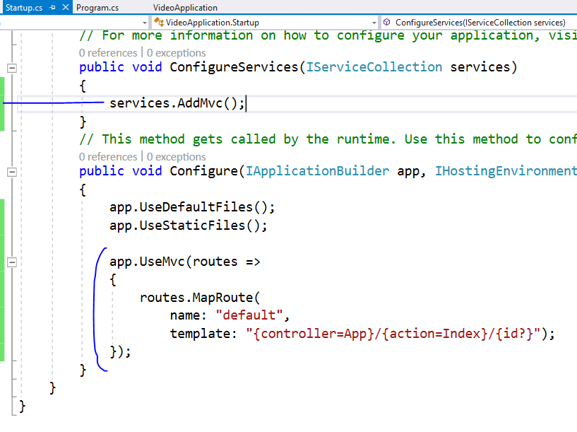

Slide 45
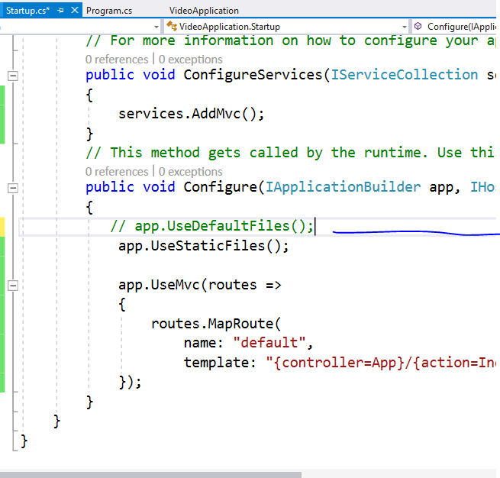
Comment this as
We don’t want to follow
File system path

Slide 46
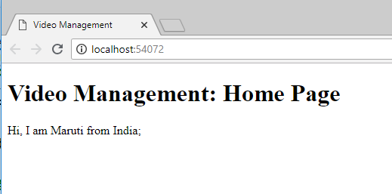

Slide 47
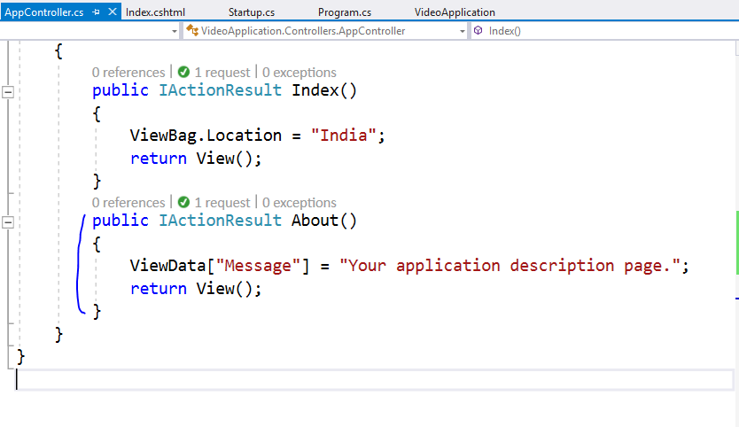

Slide 48
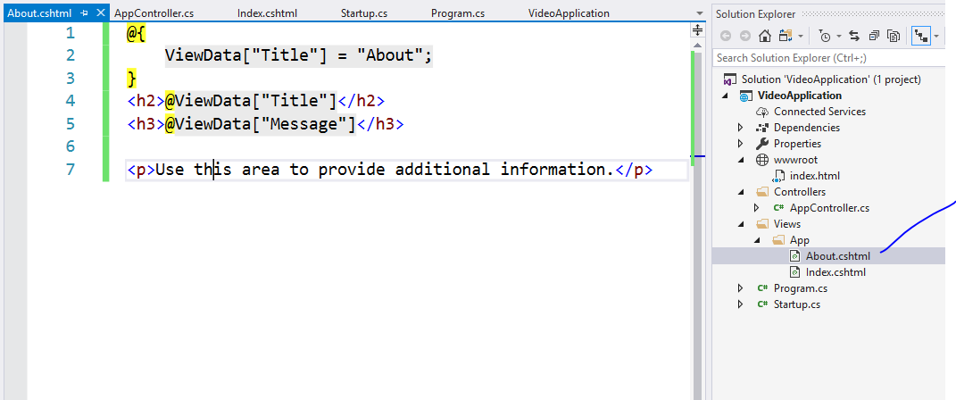

Slide 49
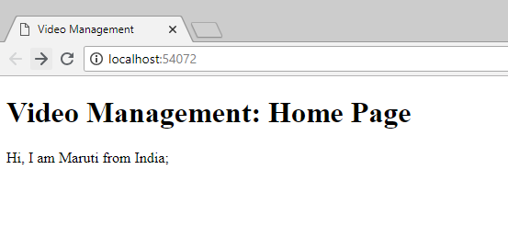
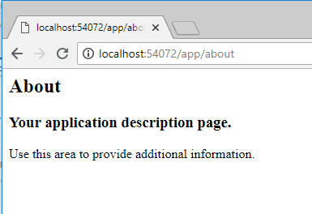
Type this url

Slide 50
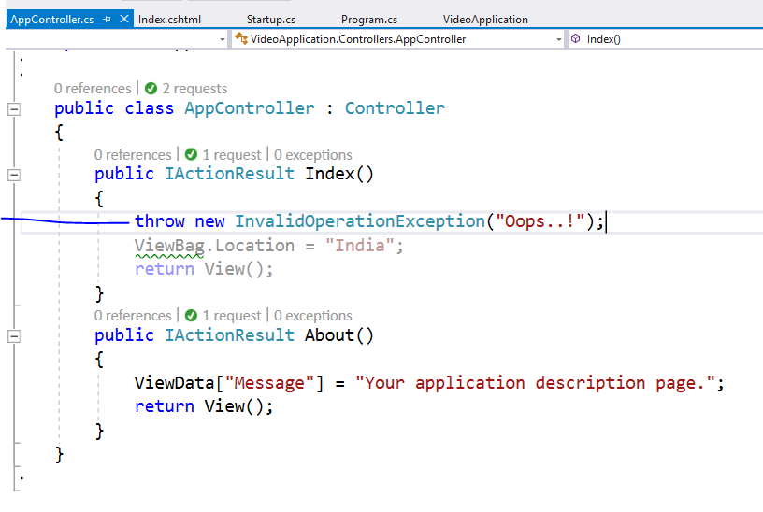
Add this line and run using ctrl + F5

Slide 51
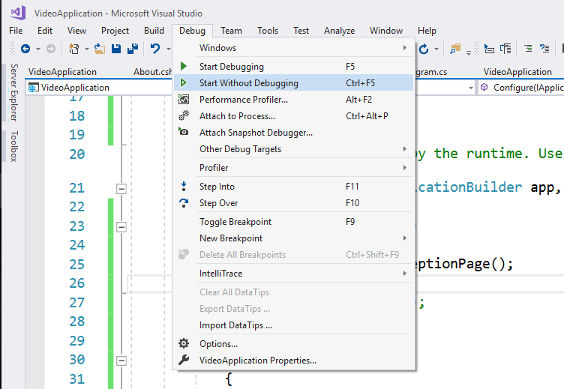

Slide 52
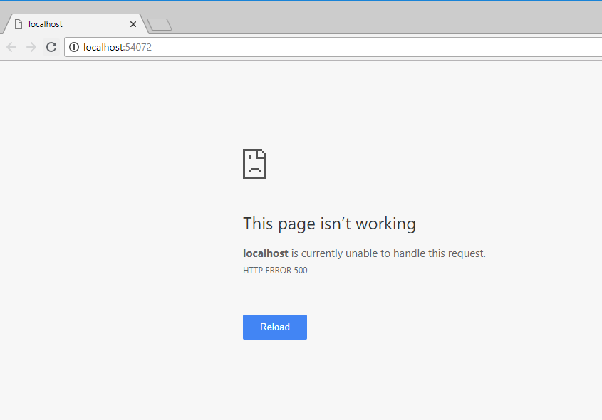
You will not get exception details

Slide 53
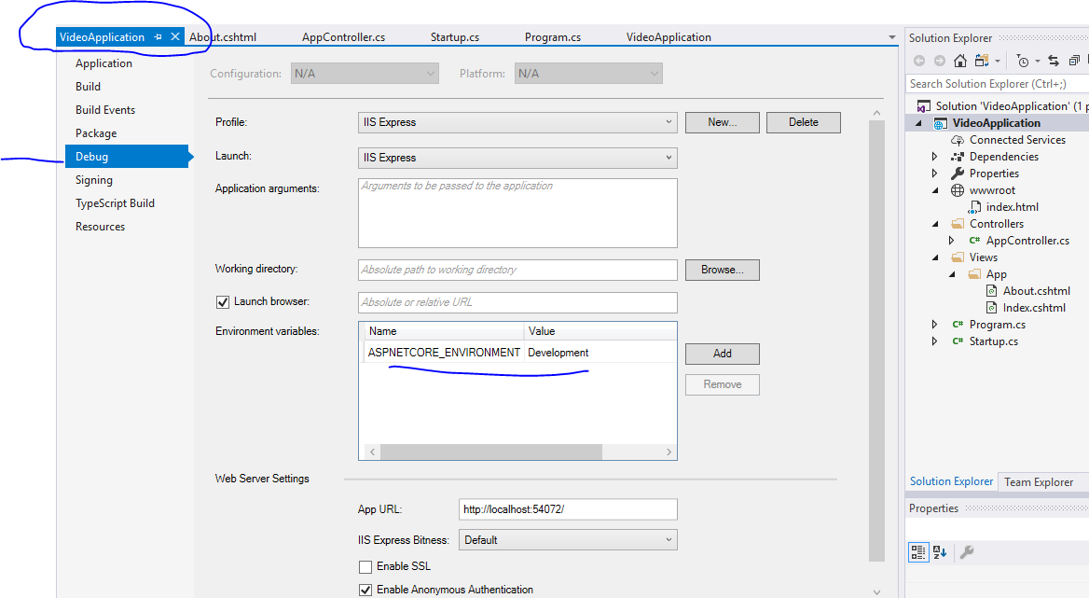

Slide 54
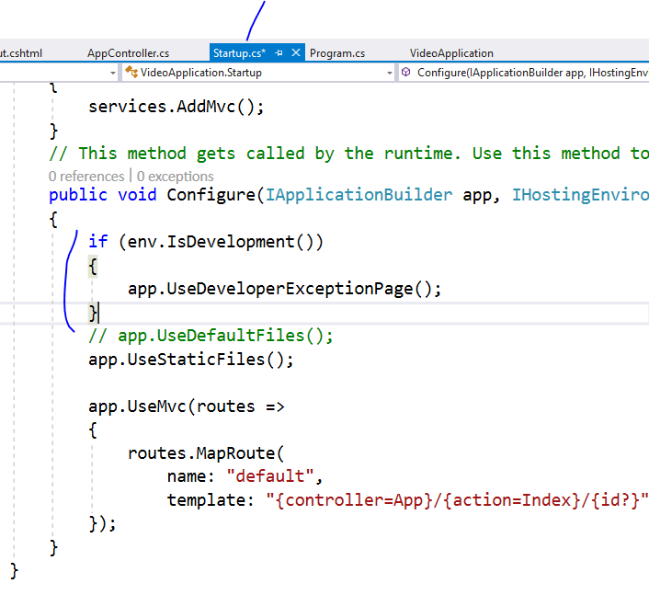

Slide 55
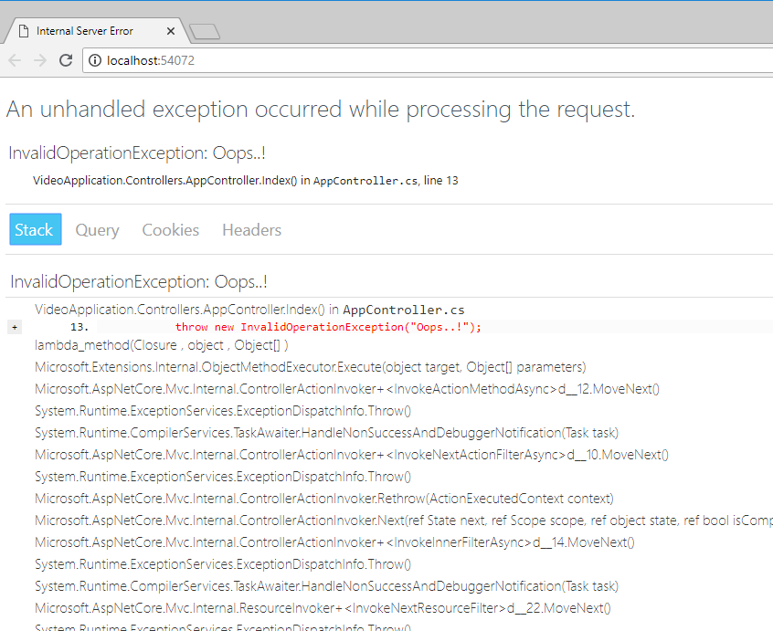

Slide 56


Slide 57


Slide 58


Slide 59


Slide 60

Remove extra things

Slide 61


Slide 62


Slide 63


Slide 64


Slide 65


Slide 66


Slide 67


Slide 68

Whatever you add here will be referred in
All the views

Slide 69


Slide 70


Slide 71


Slide 72


Slide 73


Slide 74


Slide 75

Change it to production

Slide 76
Now we are going to create Razor Page

Slide 77

Add new folder and new page

Slide 78

Pages do not require controllers

Slide 79



Slide 80

We added
2 contact actions

Slide 81


Slide 82


Slide 83


Slide 84





Slide 85


Slide 86


Slide 87



Slide 88


Slide 89
Now lets use tag helpers for same

Slide 90


Slide 91


Slide 92

Even if you click on lable it will
Focus on textbox because of
Asp-for

Slide 93
Validation : skip

Slide 94


Slide 95


Slide 96

If you want to display
Summary on top then
Set
Asp-validation-summary=“All”

Slide 101
S.O.L.I.D Principles
S stands for SRP (Single responsibility principle)
-Concerned about single focused purpose
O stands for OCP (Open closed principle)
-Open for extension but Closed for modification
L stands for LSP (Liskov substitution principle)
-the parent cannot replace the child object seamlessly
I stands for ISP ( Interface segregation principle)
-any Interface should not force any method to class which is implementing it
D stands for DIP ( Dependency inversion principle)
-Objects should be loosely coupled and injection should happen at runtime

